Slide 1

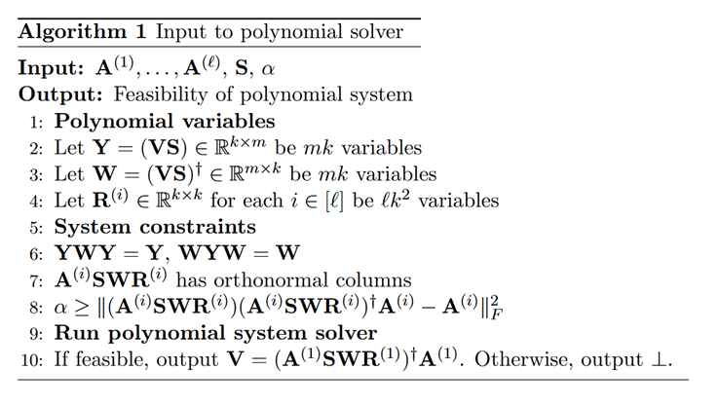
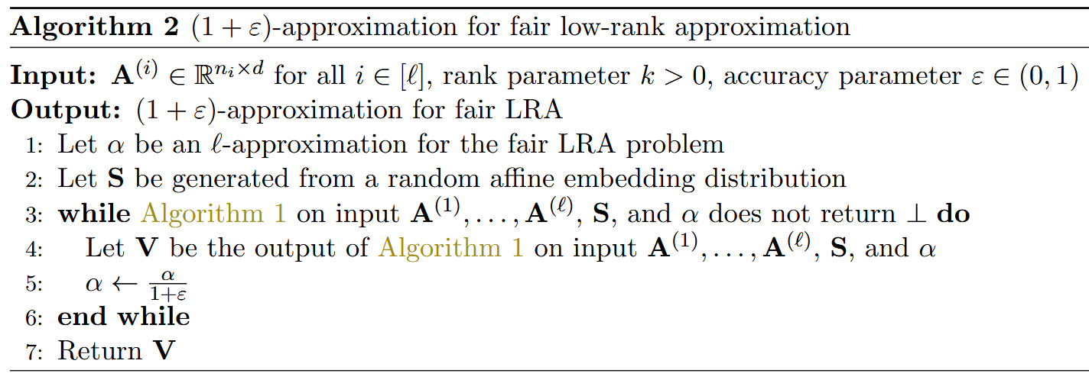

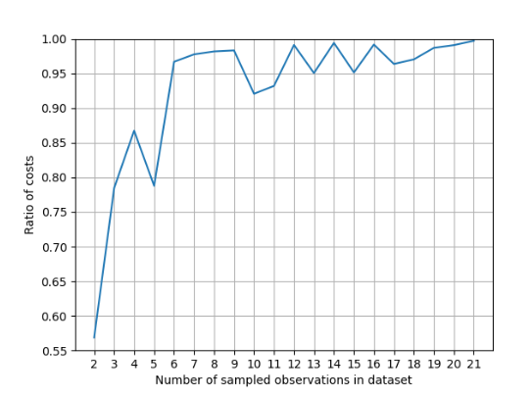



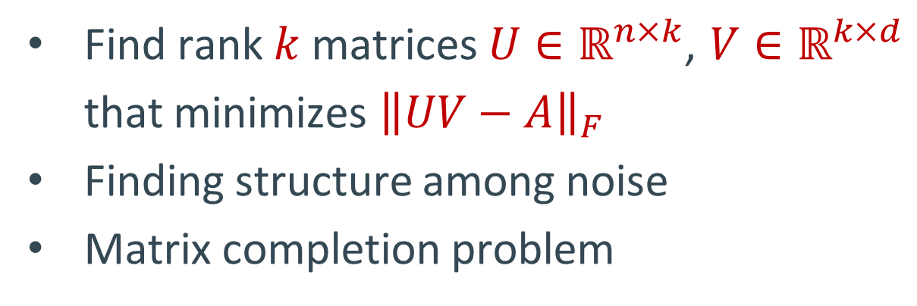
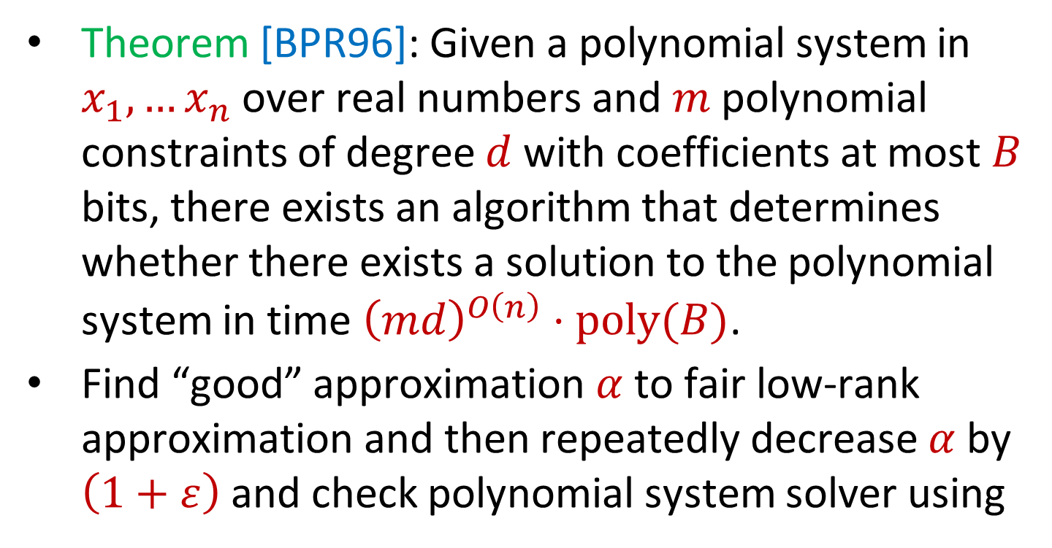



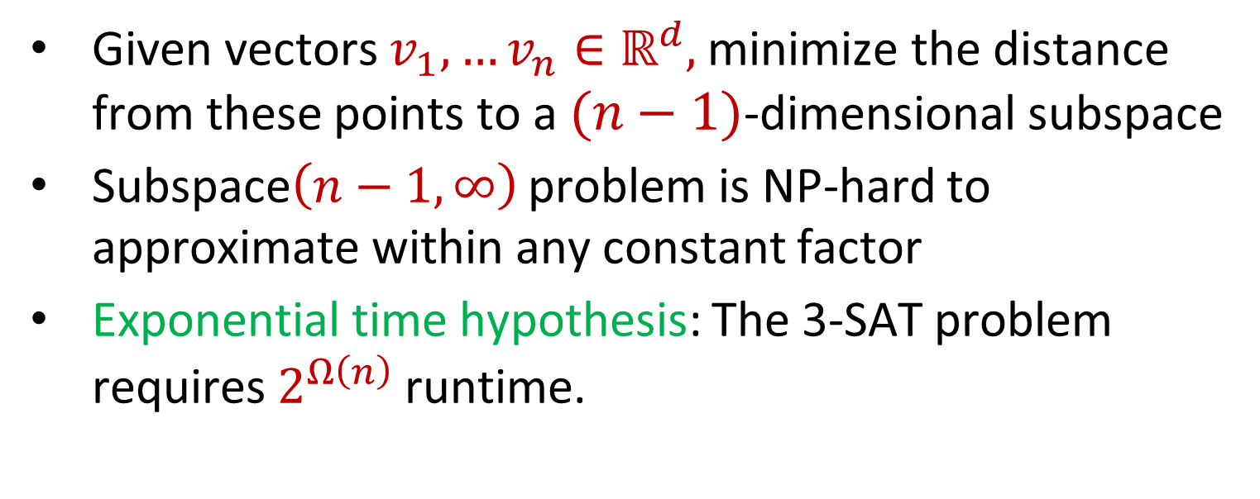
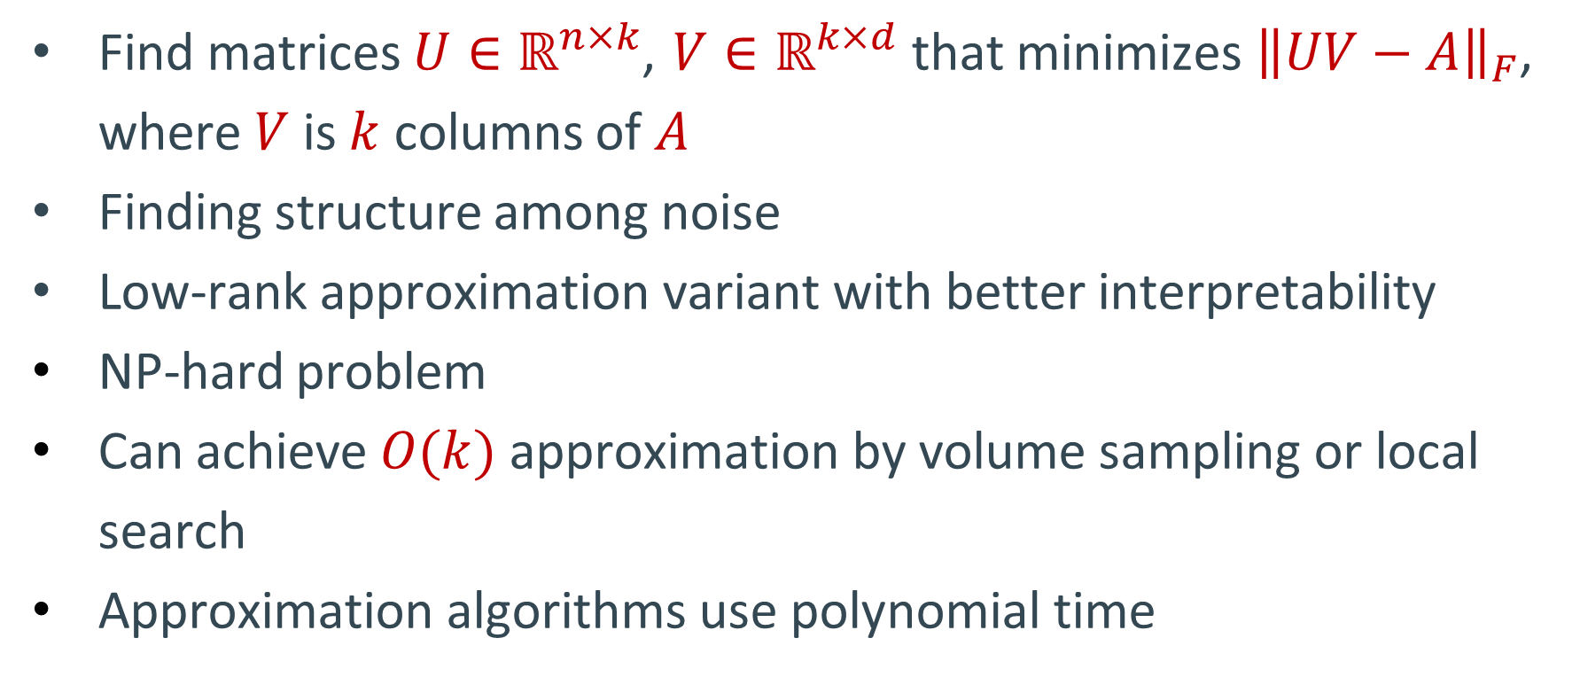
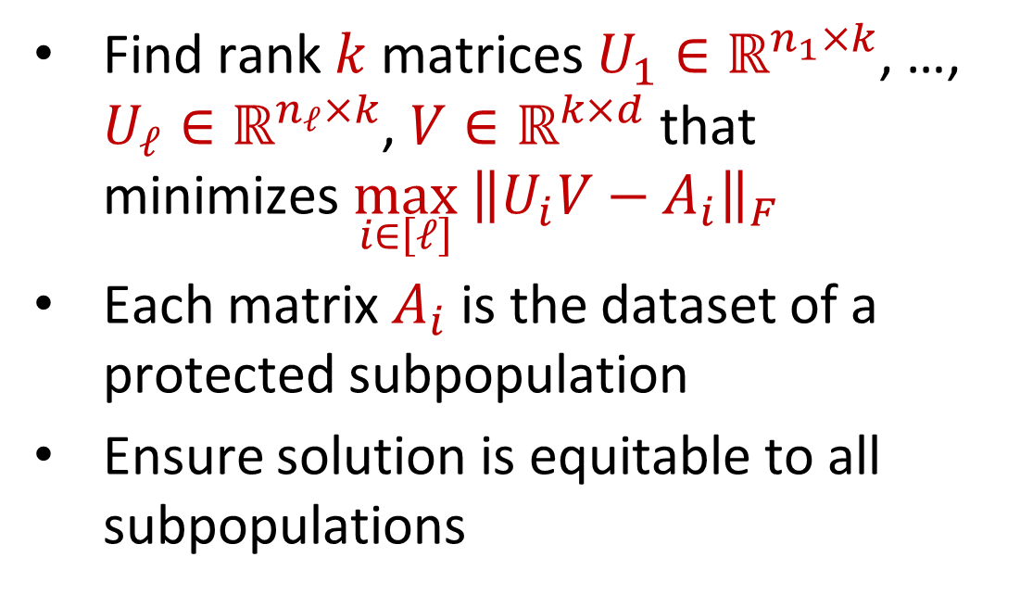
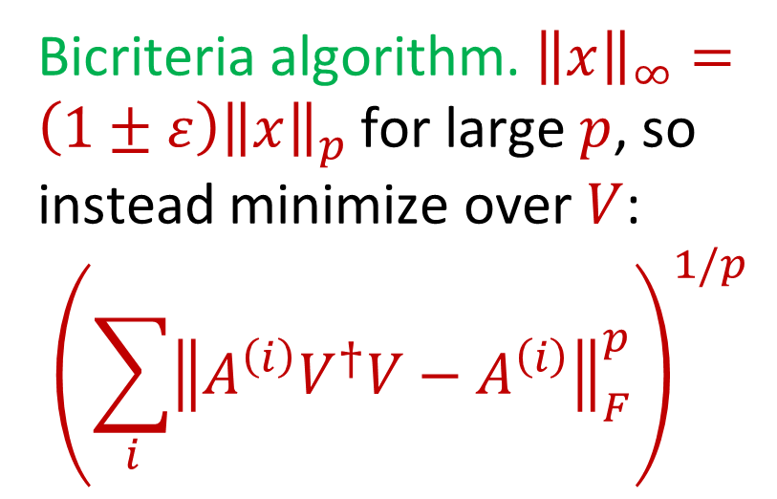
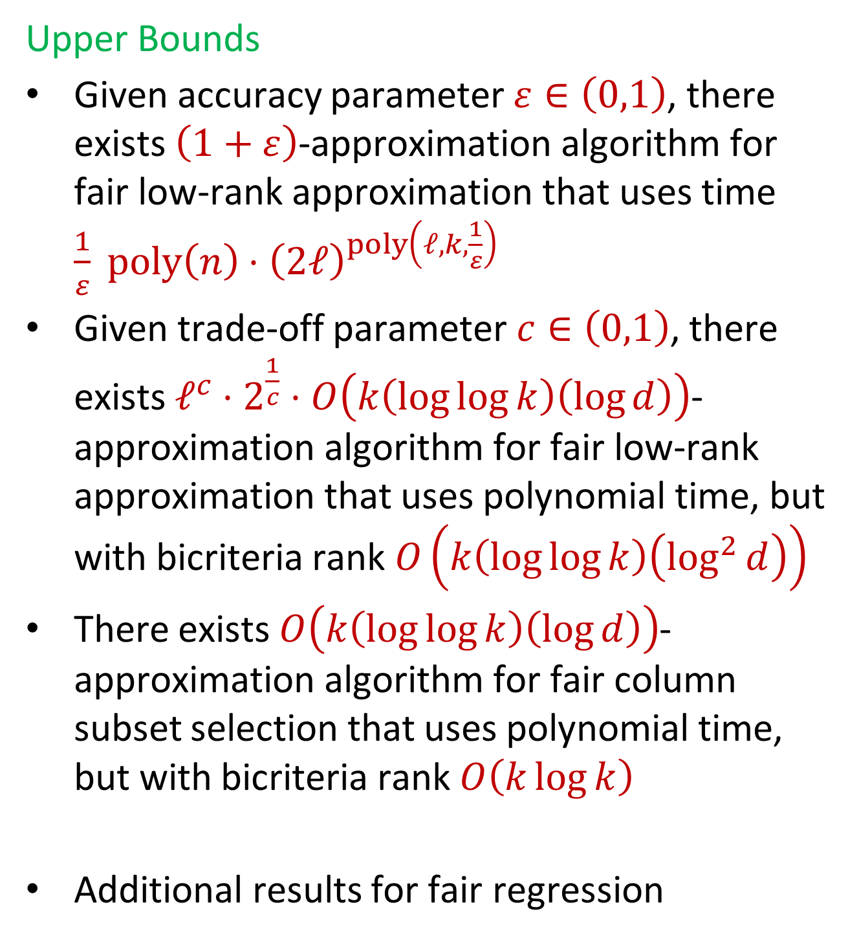

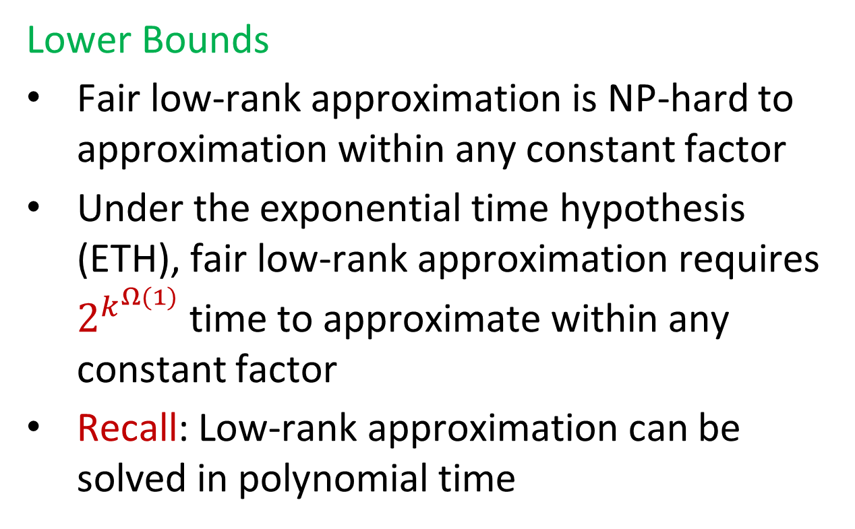

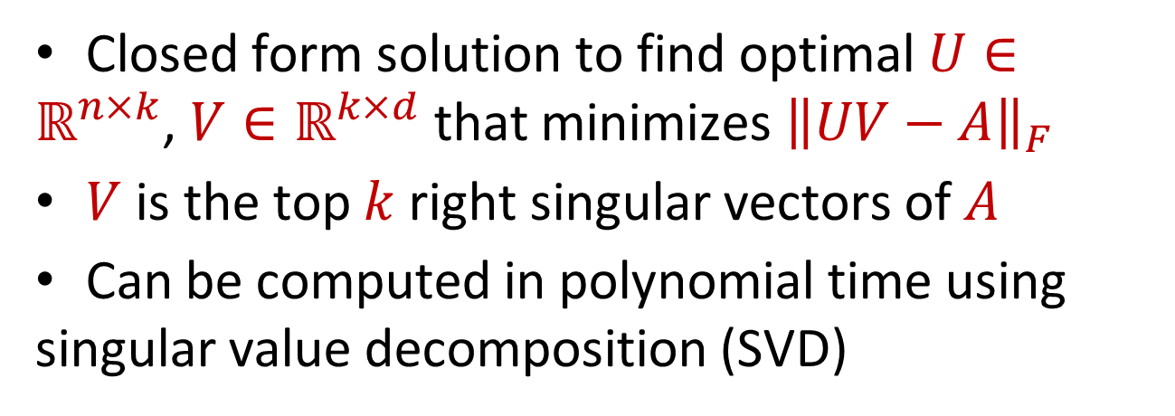


On Socially Fair Low-Rank Approximation and Column Subset Selection
Zhao Song, Simons Institute of Computing and UC Berkeley
Ali Vakilian, Toyota Technological Institute at Chicago
David P. Woodruff, Carnegie Mellon University and Google Research
Samson Zhou, Texas A&M University
Motivation
Lower Bounds
Social Fairness
$$n_{1}$$
1 3 5 -2 7 0 11 4 -8
0 0 -1 3 13 2 8 6 2
Given vectors $v_{1},…v_{n}∈ℝ^{d},$ minimize the distance from these points to a $(n−1)$-dimensional subspace
Subspace$\left(n−1,∞\right)$ problem is NP-hard to approximate within any constant factor
Exponential time hypothesis: The 3-SAT problem requires $2^{Ω\left(n\right)}$runtime.
Unfortunately, real-world machine learning algorithms across a wide variety of domains have recently produced a number of undesirable outcomes from the lens of generalization:
[BS16] noted that decision-making processes using data collected from smartphone devices reporting poor road quality could potentially underserve poorer communities with less smartphone ownership.
[KMM15] observed that search queries for CEOs overwhelmingly returned images of white men
[BG18] observed that facial recognition software exhibited different accuracy rates for white men compared with dark-skinned women.
Biased data or biased algorithms?
Better training data, fair algorithms
Find rank $k$ matrices $U_{1}∈ℝ^{n_{1}×k}$, …, $U_{ℓ}∈ℝ^{n_{ℓ}×k}$, $V∈ℝ^{k×d}$ that minimizes $\max_{i∈\left[ℓ\right]}{ \left\|U_{i}V−A_{i}\right\|}_{F}$
Each matrix $A_{i}$ is the dataset of a protected subpopulation
Ensure solution is equitable to all subpopulations
$$A_{1}$$
$$d$$
$$n_{2}$$
2 5 6 1 4 0 -7 5 3
8 7 2 1 -1 -3 -2 -4 -6
-5 3 -4 -1 -2 -1 0 -3 -1
$$A_{2}$$
$$⋮$$
Upper Bounds
$$n_{ℓ}$$
7 1 3 2 4 1 0 11 1
$$A_{ℓ}$$
Theorem [BPR96]: Given a polynomial system in $x_{1},…x_{n}$over real numbers and $m$ polynomial constraints of degree $d$ with coefficients at most $B$ bits, there exists an algorithm that determines whether there exists a solution to the polynomial system in time ${\left(md\right)}^{O\left(n\right)}⋅poly(B)$.
Find “good” approximation $α$ to fair low-rank approximation and then repeatedly decrease $α$ by $\left(1+ε\right)$ and check polynomial system solver using
Our Results
Lower Bounds
Fair low-rank approximation is NP-hard to approximation within any constant factor
Under the exponential time hypothesis (ETH), fair low-rank approximation requires $2^{k^{Ω(1)}}$ time to approximate within any constant factor
Recall: Low-rank approximation can be solved in polynomial time
Low-Rank Approximation
Find rank $k$ matrices $U∈ℝ^{n×k}$, $V∈ℝ^{k×d}$ that minimizes ${\left\|UV−A\right\|}_{F}$
Finding structure among noise
Matrix completion problem
1 3 5 -2 7 0 11 4 -8
0 0 -1 3 13 2 8 6 2
2 5 6 1 4 0 -7 5 3
8 7 2 1 -1 -3 -2 -4 -6
-5 3 -4 -1 -2 -1 0 -3 -1
7 1 3 2 4 1 0 11 1
Use dimensionality reduction to improve polynomial solver runtime
$$n$$
Upper Bounds
Given accuracy parameter $ε∈\left(0,1\right)$, there exists $\left(1+ε\right)$-approximation algorithm for fair low-rank approximation that uses time $\frac{1}{ε} poly\left(n\right)⋅{\left(2ℓ\right)}^{poly\left(ℓ,k,\frac{1}{ε}\right)}$
Given trade-off parameter $c∈\left(0,1\right)$, there exists $ℓ^{c}⋅2^{\frac{1}{c}}⋅O\left(k\left(\log{\log{k}}\right)\left(\log{d}\right)\right)$-approximation algorithm for fair low-rank approximation that uses polynomial time, but with bicriteria rank $O\left(k\left(\log{\log{k}}\right)\left(\log^{2}{d}\right)\right)$
There exists $O\left(k\left(\log{\log{k}}\right)\left(\log{d}\right)\right)$-approximation algorithm for fair column subset selection that uses polynomial time, but with bicriteria rank $O\left(k\log{k}\right)$
Additional results for fair regression
Bicriteria algorithm. ${\left\|x\right\|}_{∞}=\left(1±ε\right){\left\|x\right\|}_{p}$ for large $p$, so instead minimize over $V$:
$${\left(\sum_{i}{{\left\|A^{\left(i\right)}V^{†}V−A^{\left(i\right)}\right\|}_{F}^{p}}\right)}^{1/p}$$
Closed form solution to find optimal $U∈ℝ^{n×k}$, $V∈ℝ^{k×d}$ that minimizes ${\left\|UV−A\right\|}_{F}$
$V$ is the top $k$ right singular vectors of $A$
Can be computed in polynomial time using singular value decomposition (SVD)
$$d$$
Experiments
Use Dvoretzky’s Theorem to embed into $L_{p}$
Column Subset Selection
Credit card dataset with 30,000 observations, 23 features, e.g., previous payment statements and delays, upcoming bill statement, and whether they default. Gender used as the protected attribute
Baseline: SVD for standard low-rank approximation
Find matrices $U∈ℝ^{n×k}$, $V∈ℝ^{k×d}$ that minimizes ${\left\|UV−A\right\|}_{F}$, where $V$ is $k$ columns of $A$
Finding structure among noise
Low-rank approximation variant with better interpretability
NP-hard problem
Can achieve $O(k)$ approximation by volume sampling or local search
Approximation algorithms use polynomial time
References
[BG18]: Joy Buolamwini and Timnit Gebru. Gender shades: Intersectional accuracy disparities in commercial gender classification, FAT 2018
[BPM965]: Saugata Basu, Richard Pollack, and Marie-Fran¸coise Roy. On the combinatorial and algebraic complexity of quantifier elimination. J. ACM, 43(6):1002–1045, 1996
[BS16]: Solon Barocas and Andrew D Selbst. Big data’s disparate impact. California law
review, pages 671–732, 2016
[KMM15]: Matthew Kay, Cynthia Matuszek, and Sean A. Munson. Unequal representation and gender stereotypes in image search results for occupations, CHI 2015
https://github.com/samsonzhou/SVWZ24

